Slide 1
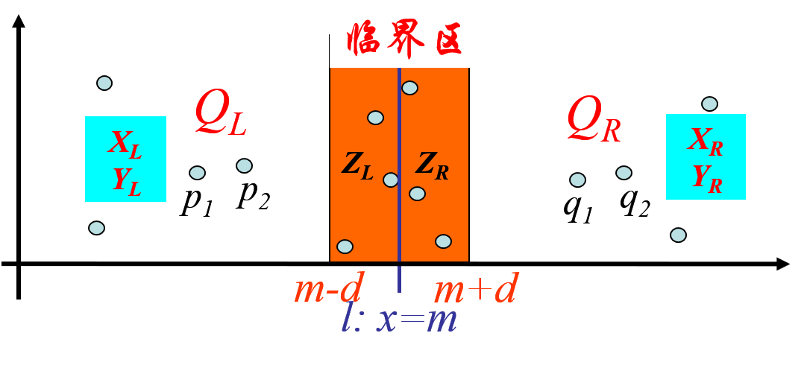
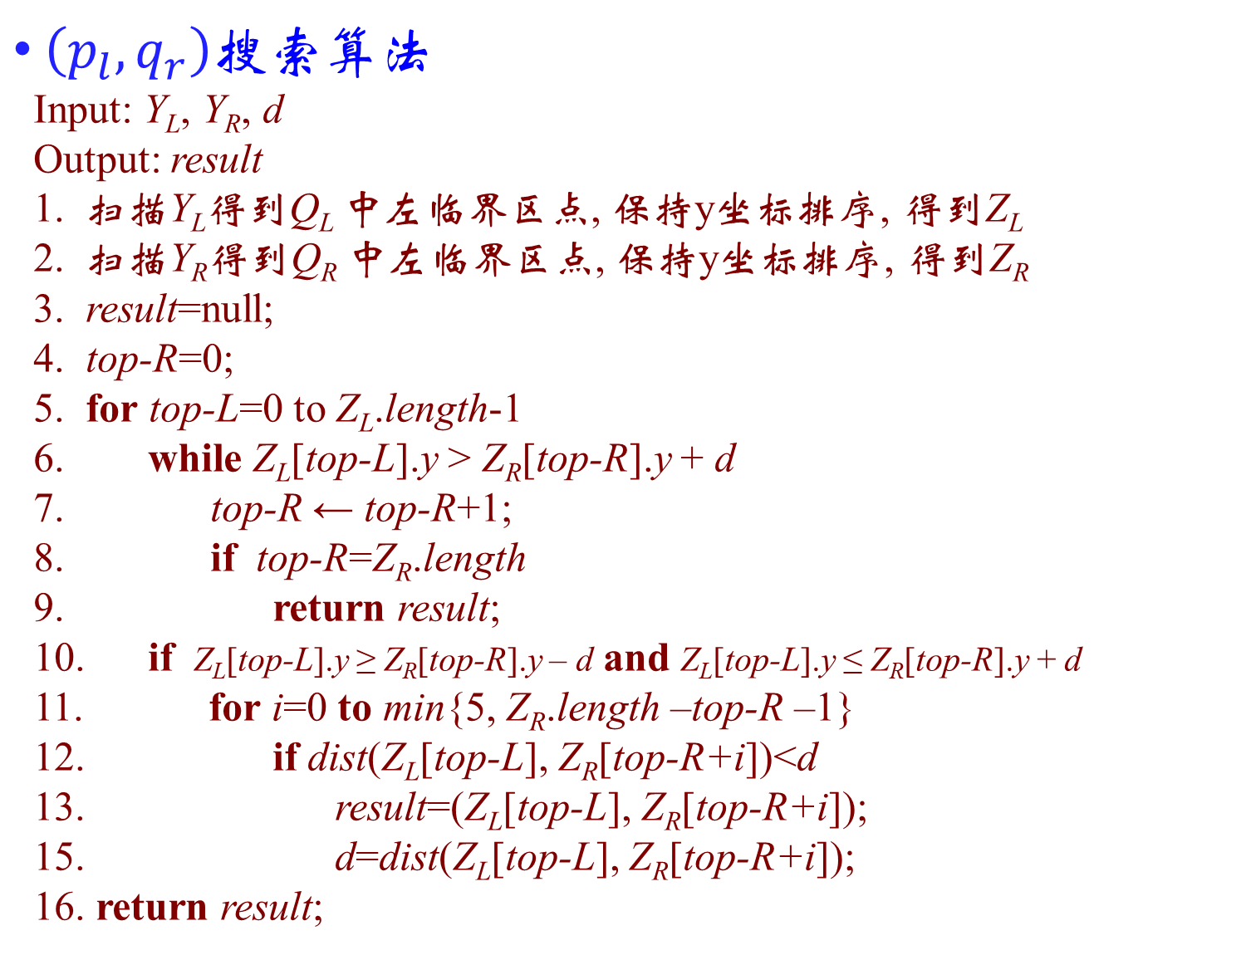
$\left(p_{l},q_{r}\right)$搜索算法
Input: Y_{L}, Y_{R}, d
Output: result
1. 扫描Y_{L}得到Q_{L} 中左临界区点, 保持y坐标排序, 得到Z_{L}
2. 扫描Y_{R}得到Q_{R} 中左临界区点, 保持y坐标排序, 得到Z_{R}
3. result=null;
4. top-R=0;
5. for top-L=0 to Z_{L}.length-1
6. while Z_{L}[top-L].y > Z_{R}[top-R].y + d
7. top-R ← top-R+1;
8. if top-R=Z_{R}.length
9. return result;
10. if Z_{L}[top-L].y ≥ Z_{R}[top-R].y – d and Z_{L}[top-L].y ≤ Z_{R}[top-R].y + d
11. for i=0 to min{5, Z_{R}.length –top-R –1}
12. if dist(Z_{L}[top-L], Z_{R}[top-R+i])<d
13. result=(Z_{L}[top-L], Z_{R}[top-R+i]);
15. d=dist(Z_{L}[top-L], Z_{R}[top-R+i]);
16. return result;

Slide 2
d=1.5
Result=null
top-L
5
3
top-R
5
3
5
3
6
6
数组中只显示各个点的y坐标值
6
6
7
6
7
9
7
9
15
9
16
10
17
11
18
12
Z_{L}
Z_{R}
Z_{L}[top-L].y > Z_{R}[top-R].y + d, 即5>3+1.5, Z_{L}中后续元素y值都不比Z_{L}[top-L].y小，因此它们与Z_{R}[top-R]的距离必然大于d, top-R增加1

Slide 3
d=1.5
Result=null
top-L
5
3
5
3
top-R
5
3
6
6
数组中只显示各个点的y坐标值
6
6
7
6
7
9
7
9
15
9
16
10
17
11
18
12
Z_{L}
Z_{R}
Z_{L}[top-L].y > Z_{R}[top-R].y + d, 即5>3+1.5, Z_{L}中后续元素y值都不比Z_{L}[top-L].y小，因此它们与Z_{R}[top-R]的距离必然大于d, top-R增加1

Slide 4
d=1.5
Result=null
top-L
5
3
5
3
5
3
top-R
6
4
数组中只显示各个点的y坐标值
6
6
7
6
7
9
7
9
15
9
16
10
17
11
18
12
Z_{L}
Z_{R}
Z_{L}[top-L].y > Z_{R}[top-R].y + d, 即5>3+1.5, Z_{L}中后续元素y值都不比Z_{L}[top-L].y小，因此它们与Z_{R}[top-R]的距离必然大于d, top-R增加1

Slide 5
d=1.5
d=1
Result =(Z_{L}[0], Z_{R}[3])
top-L
5
3
5
3
5
3
6
4
top-R
数组中只显示各个点的y坐标值
6
6
7
6
7
9
7
9
15
9
16
10
17
11
18
12
Z_{L}
Z_{R}
Z_{L}[top-L].y ≥ Z_{R}[top-R].y – d 并且 Z_{L}[top-L].y ≤ Z_{R}[top-R].y + d, 为当前Z_{L}[top-L] 连续检验最多6个Z_{R}[top-R] 中的元素（如果Z_{R}中有足够多的剩余元素）, 随后top-L增长1, top-R不变

Slide 6
d=1
Result =(Z_{L}[0], Z_{R}[3])
5
3
top-L
5
3
5
3
6
4
top-R
数组中只显示各个点的y坐标值
6
6
7
6
7
9
7
9
15
9
16
10
17
11
18
12
Z_{L}
Z_{R}
Z_{L}[top-L].y ≥ Z_{R}[top-R].y – d 并且 Z_{L}[top-L].y ≤ Z_{R}[top-R].y + d, 为当前Z_{L}[top-L] 连续检验最多6个Z_{R}[top-R] 中的元素（如果Z_{R}中有足够多的剩余元素）, 随后top-L增长1, top-R不变

Slide 7
d=1
Result =(Z_{L}[0], Z_{R}[3])
5
3
5
3
top-L
5
3
6
4
top-R
数组中只显示各个点的y坐标值
6
6
7
6
7
9
7
9
15
9
16
10
17
11
18
12
Z_{L}
Z_{R}
Z_{L}[top-L].y ≥ Z_{R}[top-R].y – d 并且 Z_{L}[top-L].y ≤ Z_{R}[top-R].y + d, 为当前Z_{L}[top-L] 连续检验最多6个Z_{R}[top-R] 中的元素（如果Z_{R}中有足够多的剩余元素）, 随后top-L增长1, top-R不变

Slide 8
d=1
Result =(Z_{L}[0], Z_{R}[3])
5
3
5
3
5
3
top-L
6
4
top-R
数组中只显示各个点的y坐标值
6
6
7
6
7
9
7
9
15
9
16
10
17
11
18
12
Z_{L}
Z_{R}
Z_{L}[top-L].y > Z_{R}[top-R].y + d, 即6>4+1, Z_{L}中后续元素y值都不比Z_{L}[top-L].y小，因此它们与Z_{R}[top-R]的距离必然大于d, top-R增加1

Slide 9
d=1
d=0
Result =(Z_{L}[3], Z_{R}[4])
5
3
5
3
5
3
top-L
6
4
数组中只显示各个点的y坐标值
6
6
top-R
7
6
7
9
7
9
15
9
16
10
17
11
18
12
Z_{L}
Z_{R}
Z_{L}[top-L].y ≥ Z_{R}[top-R].y – d 并且 Z_{L}[top-L].y ≤ Z_{R}[top-R].y + d, 为当前Z_{L}[top-L] 连续检验最多6个Z_{R}[top-R] 中的元素（如果Z_{R}中有足够多的剩余元素）, 随后top-L增长1, top-R不变

Slide 10
d=0
Result =(Z_{L}[3], Z_{R}[4])
5
3
5
3
5
3
6
4
数组中只显示各个点的y坐标值
top-L
6
6
top-R
7
6
7
9
7
9
15
9
16
10
17
11
18
12
Z_{L}
Z_{R}
Z_{L}[top-L].y ≥ Z_{R}[top-R].y – d 并且 Z_{L}[top-L].y ≤ Z_{R}[top-R].y + d, 为当前Z_{L}[top-L] 连续检验最多6个Z_{R}[top-R] 中的元素（如果Z_{R}中有足够多的剩余元素）, 随后top-L增长1, top-R不变

Slide 11
d=0
Result =(Z_{L}[3], Z_{R}[4])
5
3
5
3
5
3
6
4
数组中只显示各个点的y坐标值
6
6
top-R
top-L
7
6
7
9
7
9
15
9
16
10
17
11
18
12
Z_{L}
Z_{R}
Z_{L}[top-L].y > Z_{R}[top-R].y + d, 即7>6+0, Z_{L}中后续元素y值都不比Z_{L}[top-L].y小，因此它们与Z_{R}[top-R]的距离必然大于d, top-R增加1

Slide 12
d=0
Result =(Z_{L}[3], Z_{R}[4])
5
3
5
3
5
3
6
4
数组中只显示各个点的y坐标值
6
6
top-L
7
6
top-R
7
9
7
9
15
9
16
10
17
11
18
12
Z_{L}
Z_{R}
Z_{L}[top-L] > Z_{R}[top-R] + d, 即7>6+0, Z_{L}中后续元素y值都不比Z_{L}[top-L].y小，因此它们与Z_{R}[top-R]的距离必然大于d, top-R增加1

Slide 13
d=0
Result =(Z_{L}[3], Z_{R}[4])
5
3
5
3
5
3
6
4
数组中只显示各个点的y坐标值
6
6
top-L
7
6
7
9
top-R
7
9
15
9
16
10
17
11
18
12
Z_{L}
Z_{R}
Z_{L}[top-L].y < Z_{R}[top-R].y - d, 即7<9-0, Z_{R}中后续元素y值都不比Z_{R}[top-R].y小，因此它们与Z_{L}[top-L]的距离必然大于d, top-L增加1

Slide 14
d=0
Result =(Z_{L}[3], Z_{R}[4])
5
3
5
3
5
3
6
4
数组中只显示各个点的y坐标值
6
6
7
6
top-L
7
9
top-R
7
9
15
9
16
10
17
11
18
12
Z_{L}
Z_{R}
Z_{L}[top-L].y < Z_{R}[top-R].y - d, 即7<9-0, Z_{R}中后续元素y值都不比Z_{R}[top-R].y小，因此它们与Z_{L}[top-L]的距离必然大于d, top-L增加1

Slide 15
d=0
Result =(Z_{L}[3], Z_{R}[4])
5
3
5
3
5
3
6
4
数组中只显示各个点的y坐标值
6
6
7
6
7
9
top-R
top-L
7
9
15
9
16
10
17
11
18
12
Z_{L}
Z_{R}
Z_{L}[top-L].y < Z_{R}[top-R].y - d, 即7<9-0, Z_{R}中后续元素y值都不比Z_{R}[top-R].y小，因此它们与Z_{L}[top-L]的距离必然大于d, top-L增加1

Slide 16
d=0
Result =(Z_{L}[3], Z_{R}[4])
5
3
5
3
5
3
6
4
数组中只显示各个点的y坐标值
6
6
7
6
7
9
top-R
7
9
top-L
15
9
16
10
17
11
18
12
Z_{L}
Z_{R}
Z_{L}[top-L].y > Z_{R}[top-R].y + d, 即15>9+0, Z_{L}中后续元素y值都不比Z_{L}[top-L].y小，因此它们与Z_{R}[top-R]的距离必然大于d, top-R增加1

Slide 17
d=0
Result =(Z_{L}[3], Z_{R}[4])
5
3
5
3
5
3
6
4
数组中只显示各个点的y坐标值
6
6
7
6
7
9
7
9
top-R
top-L
15
9
16
10
17
11
18
12
Z_{L}
Z_{R}
Z_{L}[top-L].y > Z_{R}[top-R].y + d, 即15>9+0, Z_{L}中后续元素y值都不比Z_{L}[top-L].y小，因此它们与Z_{R}[top-R]的距离必然大于d, top-R增加1

Slide 18
d=0
Result =(Z_{L}[3], Z_{R}[4])
5
3
5
3
5
3
6
4
数组中只显示各个点的y坐标值
6
6
7
6
7
9
7
9
top-L
15
9
top-R
16
10
17
11
18
12
Z_{L}
Z_{R}
Z_{L}[top-L].y > Z_{R}[top-R].y + d, 即15>9+0, Z_{L}中后续元素y值都不比Z_{L}[top-L].y小，因此它们与Z_{R}[top-R]的距离必然大于d, top-R增加1

Slide 19
d=0
Result =(Z_{L}[3], Z_{R}[4])
5
3
5
3
5
3
6
4
数组中只显示各个点的y坐标值
6
6
7
6
7
9
7
9
top-L
15
9
16
10
top-R
17
11
18
12
Z_{L}
Z_{R}
Z_{L}[top-L].y > Z_{R}[top-R].y + d, 即15>10+0, Z_{L}中后续元素y值都不比Z_{L}[top-L].y小，因此它们与Z_{R}[top-R]的距离必然大于d, top-R增加1

Slide 20
d=0
Result =(Z_{L}[3], Z_{R}[4])
5
3
5
3
5
3
6
4
数组中只显示各个点的y坐标值
6
6
7
6
7
9
7
9
top-L
15
9
16
10
17
11
top-R
18
12
Z_{L}
Z_{R}
Z_{L}[top-L].y > Z_{R}[top-R].y + d, 即15>11+0, Z_{L}中后续元素y值都不比Z_{L}[top-L].y小，因此它们与Z_{R}[top-R]的距离必然大于d, top-R增加1

Slide 21
d=0
Result =(Z_{L}[3], Z_{R}[4])
5
3
5
3
5
3
6
4
数组中只显示各个点的y坐标值
6
6
7
6
7
9
7
9
top-L
15
9
16
10
17
11
18
12
top-R
Z_{L}
Z_{R}
Z_{L}[top-L].y > Z_{R}[top-R].y + d, 即15>12+0, Z_{L}中后续元素y值都不比Z_{L}[top-L].y小，因此它们与Z_{R}[top-R]的距离必然大于d, top-R增加1, top-R=Z_{R}.length, 算法终止

Slide 22


$\left(p_{l},q_{r}\right)$搜索算法时间复杂性
获取Z_{L}和Z_{R}需要O(n)时间
每次使得top-L增加1或者top-R增加1需要消耗常数时间
top-L或者top-R增长到n/2时算法结束, 最外层for循环耗时O(n)
算法时间复杂性为O(n)
$\left(p_{l},q_{r}\right)$搜索算法
Input: Y_{L}, Y_{R}, d
Output: result
1. 扫描Y_{L}得到Q_{L} 中左临界区点, 保持y坐标排序, 得到Z_{L}
2. 扫描Y_{R}得到Q_{R} 中左临界区点, 保持y坐标排序, 得到Z_{R}
3. result=null;
4. top-R=0;
5. for top-L=0 to Z_{L}.length-1
6. while Z_{L}[top-L].y > Z_{R}[top-R].y + d
7. top-R ← top-R+1;
8. if top-R=Z_{R}.length
9. return result;
10. if Z_{L}[top-L].y ≥ Z_{R}[top-R].y – d and Z_{L}[top-L].y ≤ Z_{R}[top-R].y + d
11. for i=0 to min{5, Z_{R}.length –top-R – 1}
12. if dist(Z_{L}[top-L], Z_{R}[top-R+i])<d
13. result=(Z_{L}[top-L], Z_{R}[top-R+i]);
15. d=dist(Z_{L}[top-L], Z_{R}[top-R+i]);
16. return result;

